Slide 1
Overview of EIC RF Systems
Geetha Narayan
For EIC RF Controls Team
October 13, 2025
This work was supported by the EIC Project and the U.S. Department of Energy, Contract DE-SC0012704

Slide 2
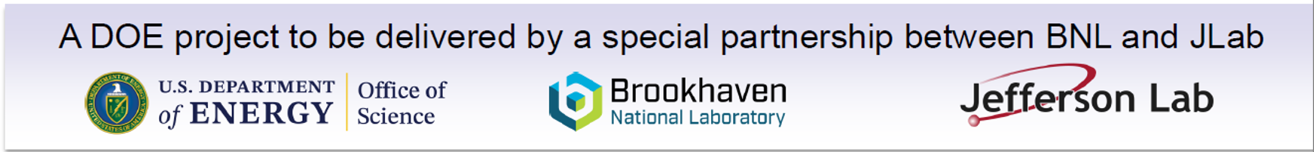
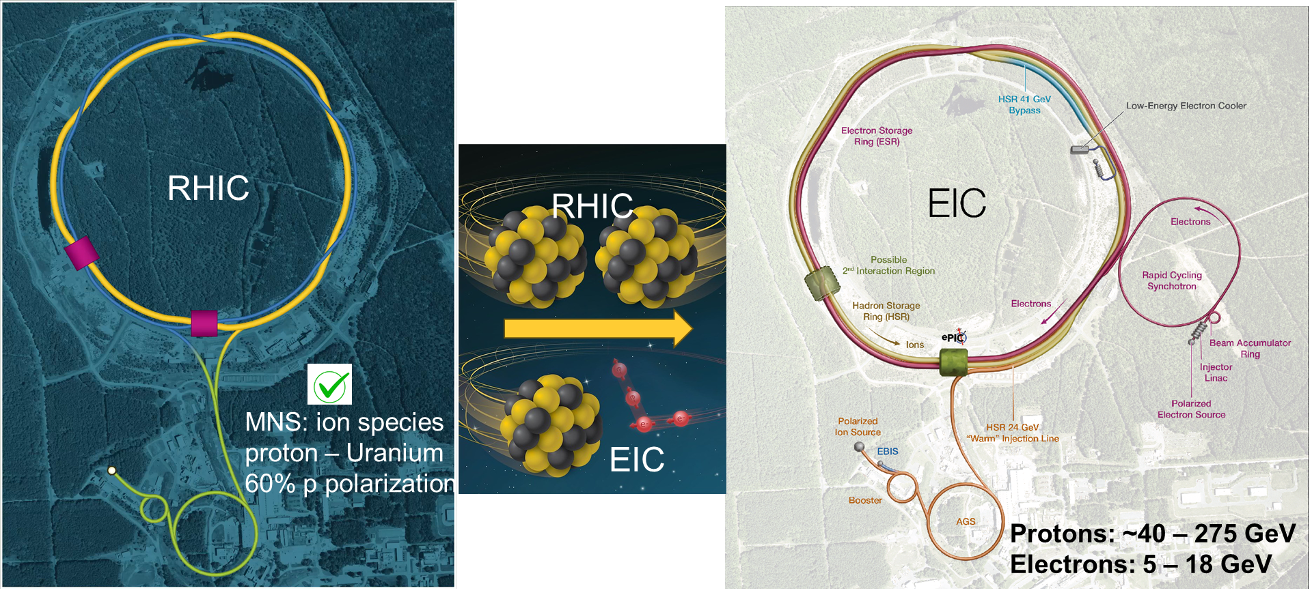

Introduction
EIC is a unique, high-energy, high-luminosity, polarized beam collider that will be one of the most challenging and exciting accelerator complexes ever built - only new collider in the next decades.
From RHIC to EIC*
“The science questions that an EIC will answer are central to completing an understanding of atoms as well as being integral to the agenda of nuclear physics today.” (National Academy of Sciences, 2018)
* Not to scale

Slide 3
EIC Parameters
Design Goals:
High Luminosity:
L= 10³³ – 10³⁴cm⁻²sec⁻¹
Highly Polarized Beams:
70% (electrons, protons, light ions)
Large Center of Mass Energy Range:
E_{cm} = 20 – 140 GeV
Large Ion Species Range:
Protons – Uranium
Large Detector Acceptance and Good Background Conditions
Possibility to implement a Second Interaction Region (IR)
Key Accelerator Concepts:
Ribbon-like (flat) hadron beam
(11:1 transverse emittance & beam size ratio)
Large crossing angle (25 mrad)
Beam-beam limits for both beams
(0.1 e/ 0.01 p)
Spin preservation from source to collisions (protons and electrons)
Very high bunch intensities and circulating beam currents (1 A (p), 2.5 A (e))
High quality beams with preserved emittance:
Low energy cooling (p)
+ Stochastic cooling (ions)
Upgrade path: high-energy hadron cooling at collisions

Slide 4
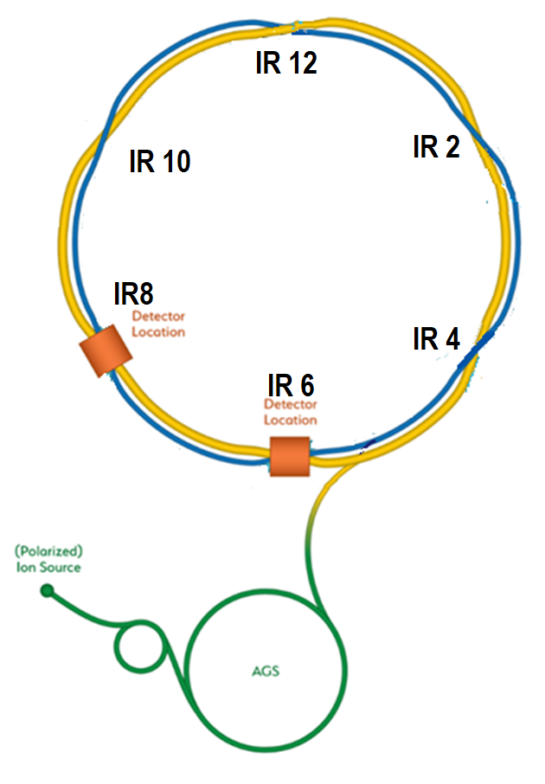

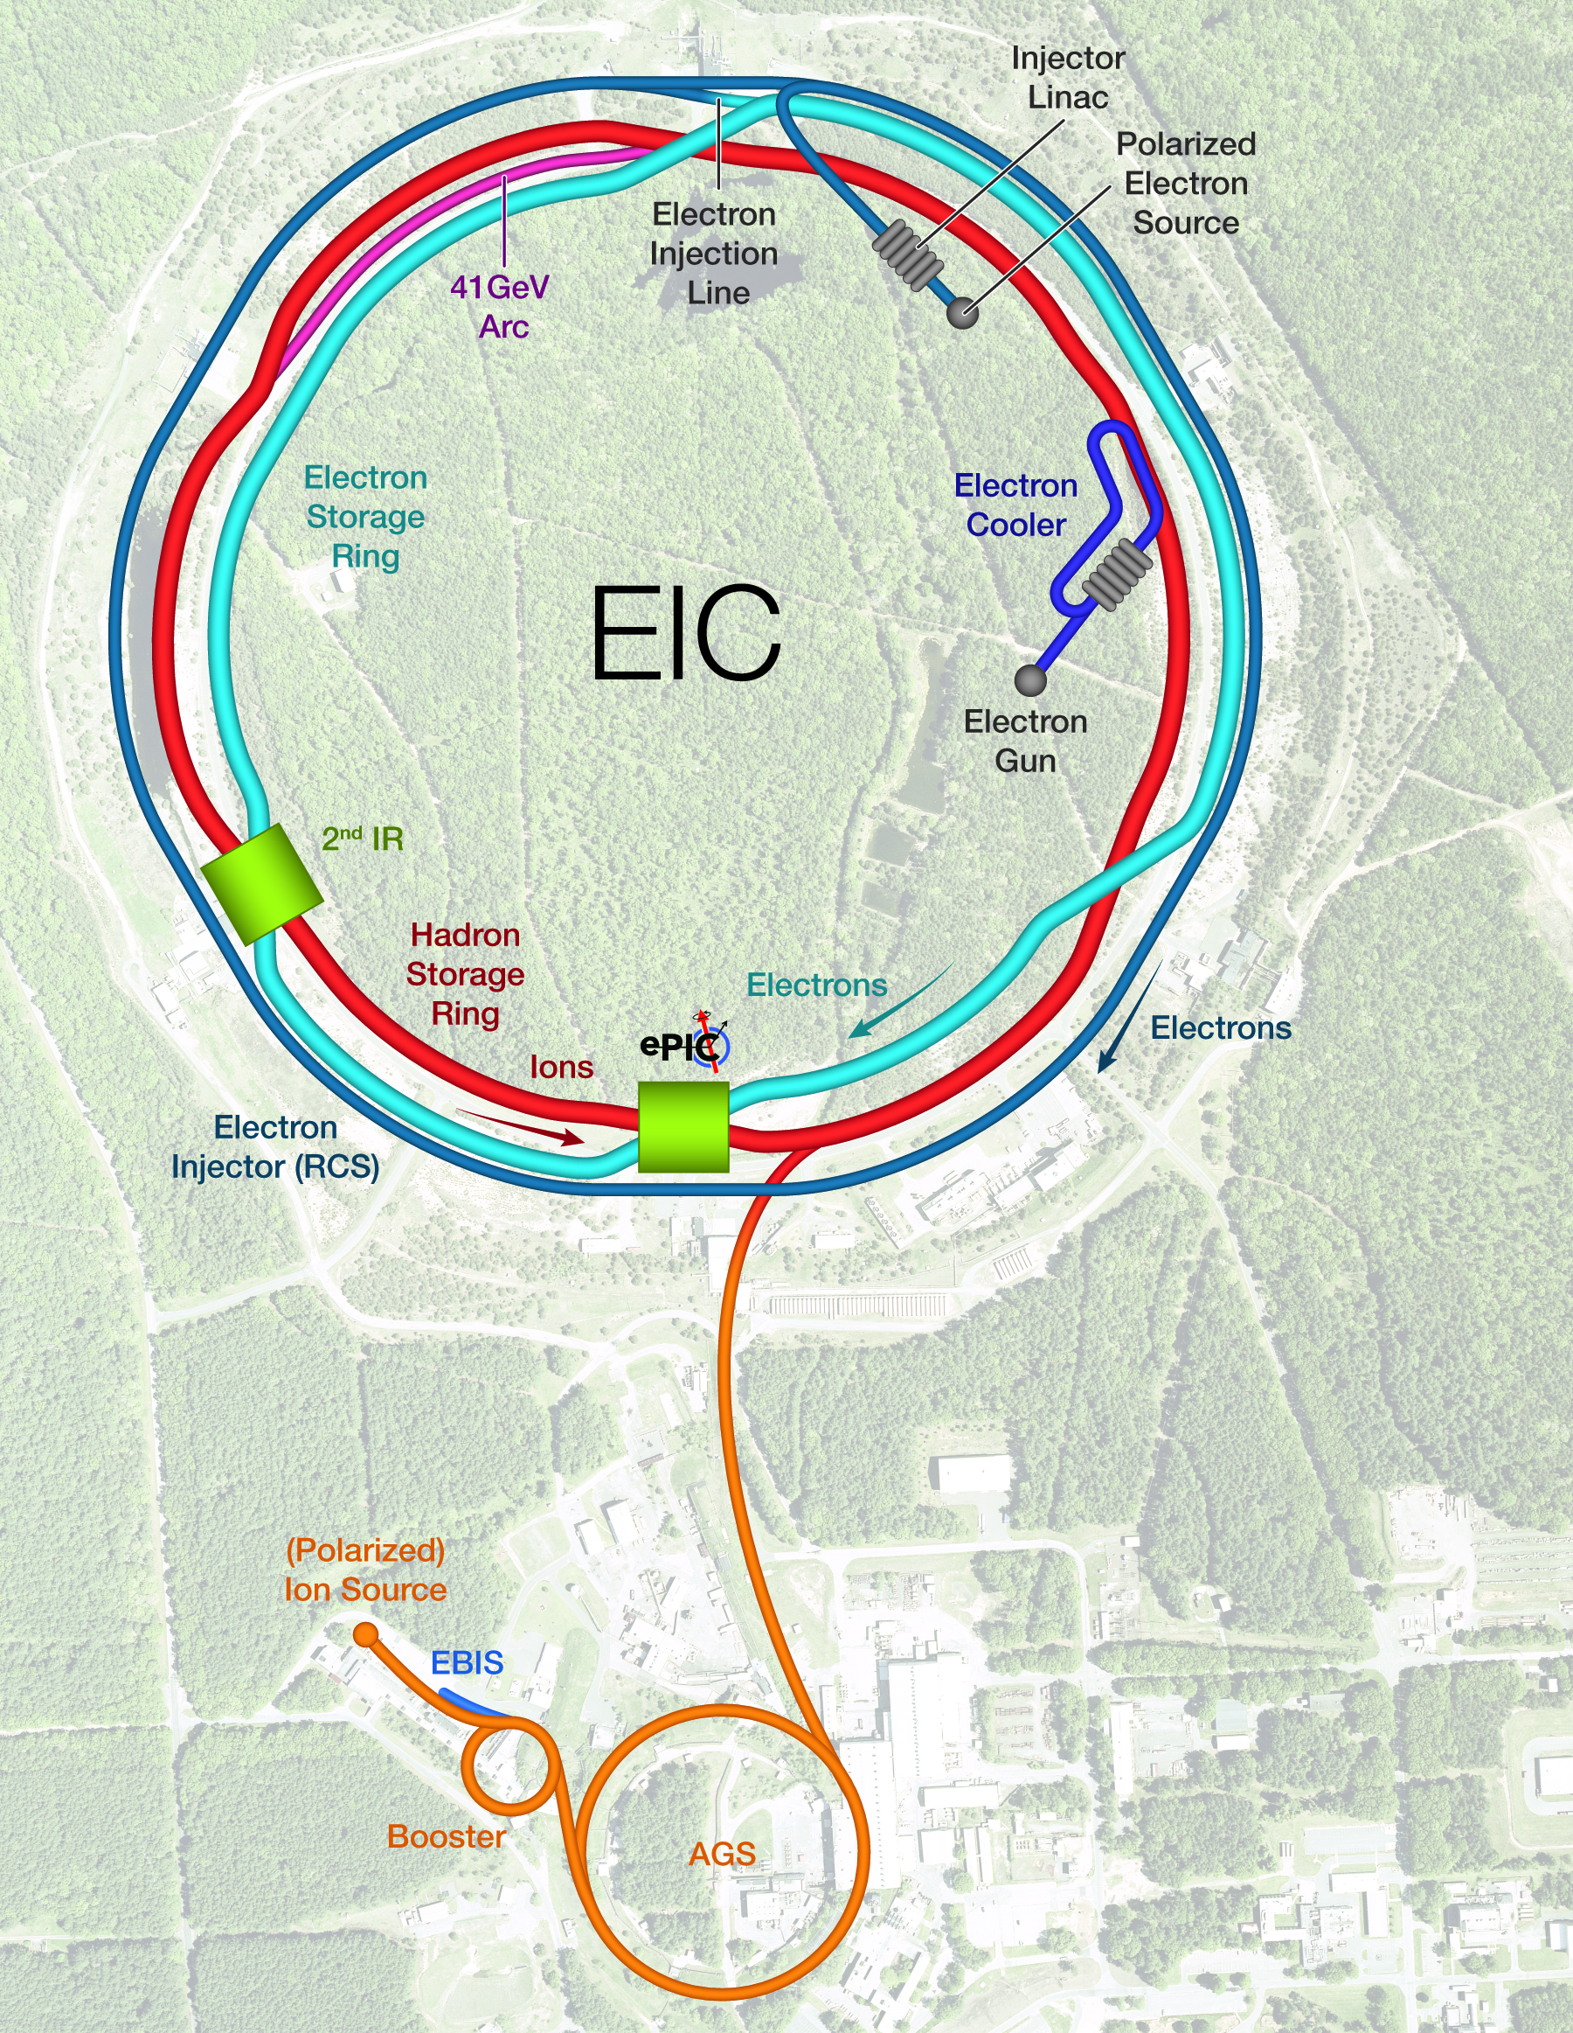
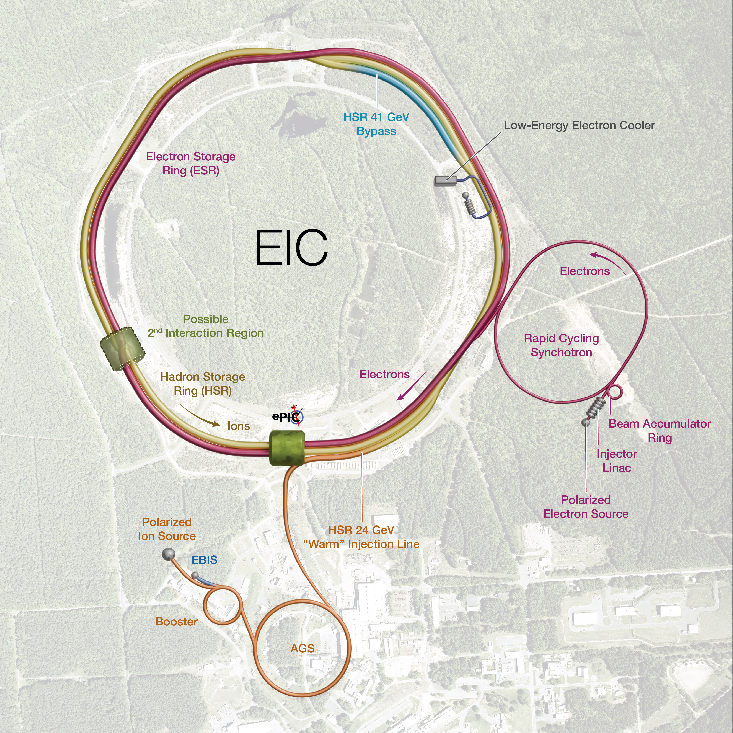
EIC Design Evolution
Hadron Storage Ring comprised of “Blue” and “Yellow” RHIC arcs
Electron complex to be installed in existing RHIC tunnel
Major EIC scope changes since 2023:
New electron injector chain
RCS outside the RHIC tunnel
Beam Accumulator Ring (BAR)
No strong Hadron Cooling (SHC)
Add Low Energy Electron Cooling (LEC)
Stochastic cooling (SC) under consideration
RHIC
2023
LLRF Workshop 2022
Electron-Ion Collider RF Systems, K. Mernick
2025

Slide 5



EIC Facility
Existing Accelerator Scope
Polarized ion/proton sources
Ion injection and acceleration systems (Linac, Booster, AGS)
New Scope
Hadron Storage Ring (40, 100 – 275 GeV)
Electron Pre-Injector (750 MeV Linac)
Electron Rapid Cycling Synchrotron (0.75 GeV – Top Energy)
Electron Storage Ring (5 GeV – 18 GeV)
Interaction Region, Provision for a 2nd
Hadron Injection Cooling System
General Purpose Collider Detector
CM
CM
CM
Cryoplant & Bldg
c/o S.Nagaitsev

Slide 6
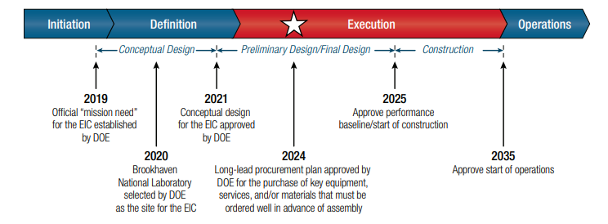
Project Milestones
The EIC facility is planning to start construction in 2026 following the conclusion of RHIC operations at the end of 2025
2026
2038
2035
Start of Physics Program
c/o L. Lari Sep 2025
IR06 ESR and HSR Crab Cryomodule layout
ePIC
c/o K. Hamdi

Slide 7
Subproject Strategy
The EIC Project is proposing a staged approach to proceed as soon as possible into construction and operations.
Initial Science Program Scope | polarized e- 7nC / bunch 5 – 10 GeV polarized p 100 – 250 GeV nuclear beams 100 GeV/u | Accelerator Storage Rings (ASR) | Hadron Storage Ring (HSR) modifications up to 250 GeV for protons Electron Storage Ring (ESR) up to 10 GeV Infrastructures to accommodate EIC needed services.
x |  | Detector (DET) | ePIC Detector - Including Detector Solenoid Magnet and return Flux & installation. - Auxiliary detector systems are included.
 |  | Interaction Region (IR) | Interaction Region including the SC magnets 197 MHz crab cavities machine protection systems.
x |  | Electron Injectors (EIN) | Electron Injectors incl. the LINAC Beam Accumulator Ring (BAR) Rapid Cycling Synchrotron (RCS) up to 10 GeV and related infrastructure.
Full Scope | polarized e- 28nC / bunch 18 GeV polarized p 275 GeV nuclear beams 110 GeV/u | Energy and Luminosity Ramp-up (ELR) | Accelerator scope required to increase Energy and Luminosity incl. up to 18GeV e⁻ (RCS SRF & Cryo) 394 MHz crab cavities 41 GeV by-pass Low Energy e⁻ Cooler ESR and HSR RF power supplies

Slide 8
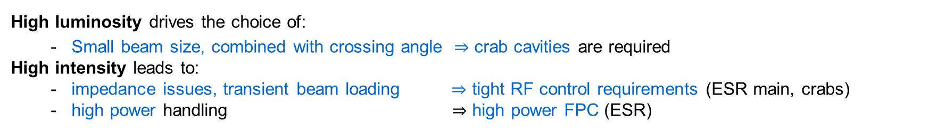
Beam Scenarios & RF
 |  | High Lumi |  | High Ecm
 |  | e- | p+ | e- | p+
CoM Energy | (GeV) | 105 |  | 140
Luminosity | (cm⁻² s⁻¹) | ~10³⁴ |  | ~10³³
Energy | (GeV) | 10 | 275 | 18 | 275
No. bunches |  | 1160 | 1160 | 290 | 290
Bunch charge | (nC) | 28 | 11 | 10 | 30
Beam Current | (A) | 2.5 | 1 | 0.23 | 0.69
Bunch length | (rms mm) | 60 | 7 | 60 | 7
c/o S. Verdu’ Andres
High luminosity drives the choice of:
- Small beam size, combined with crossing angle $⇒$ crab cavities are required
High intensity leads to:
- impedance issues, transient beam loading $⇒$ tight RF control requirements (ESR main, crabs)
- high power handling $⇒$ high power FPC (ESR)

Slide 9
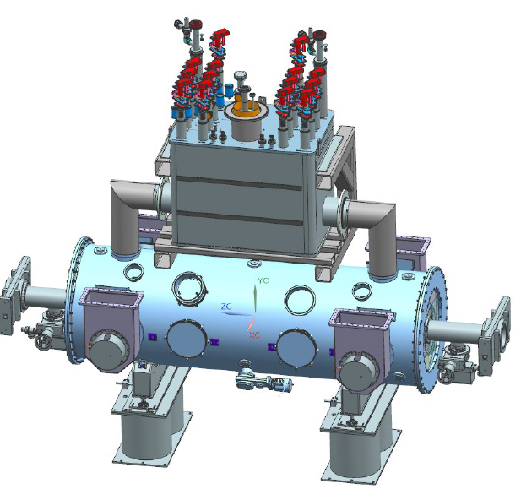
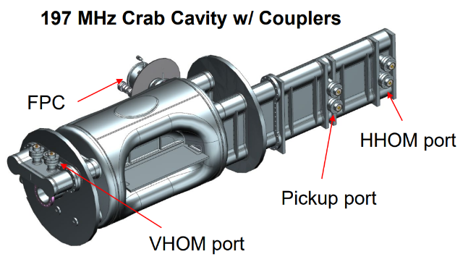
Challenges to RF Systems
EIC System | Notable Challenges
RCS | Accurate control of SRF cavities in a dynamically ramping accelerator ring Achieve precise swap-out injection into the ESR
ESR + HSR Store Systems | Demanding RF feedback requirements to reduce cavity impedance Very strong transient beam loading generated by beam abort gap
ESR Store | Reverse Phase Mode (as used in KEKB) is planned to mitigate transient beam loading
HSR NCRF | Bunch-split which maintains longitudinal emittance Requires appropriate transient beam loading compensation
HSR Energy Ramp | High current, MHz level tuning, and precise control at every injection
Crabs | Fundamental crab mode can drive strong transverse instabilities High-gain RF feedback required to reduce effective cavity impedance by ~2500 (68 dB) One-Turn Delay Feedback (OTFB) required to further reduce impedance at betatron side bands for additional factor of 10 (20 dB) Low noise injected by fundamental crab mode can limit luminosity lifetime leading to tight RF noise requirements Accurate control of crabbing vs un-crabbing fields from multiple cavities Requires cavity to cavity amplitude and phase control with cavities at different location Long term drift compensation and beam-based feedback are essential
591 MHz 1-cell Cryomodule
c/o J. Matalevich
c/o N. Huque
c/o M. Blaskiewicz EIC Tech Design Review 2023
c/o T. Mastoridis BNL-222748-2022-TECH

Slide 10
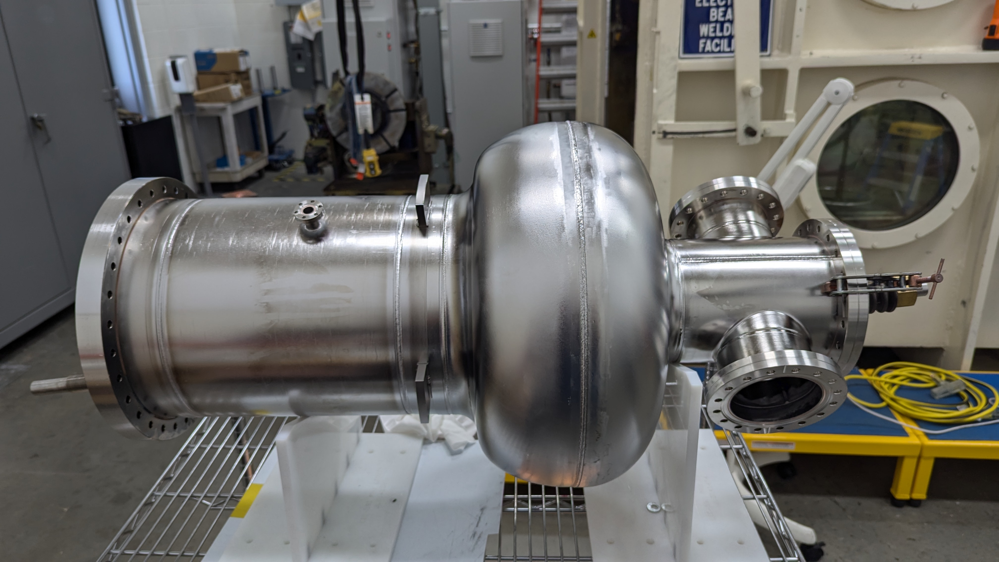

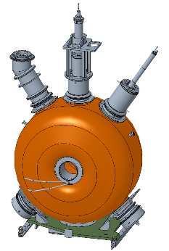
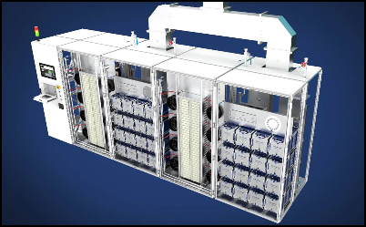
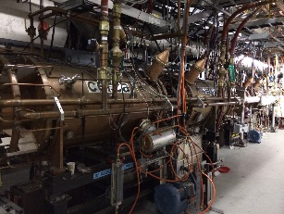
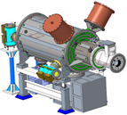
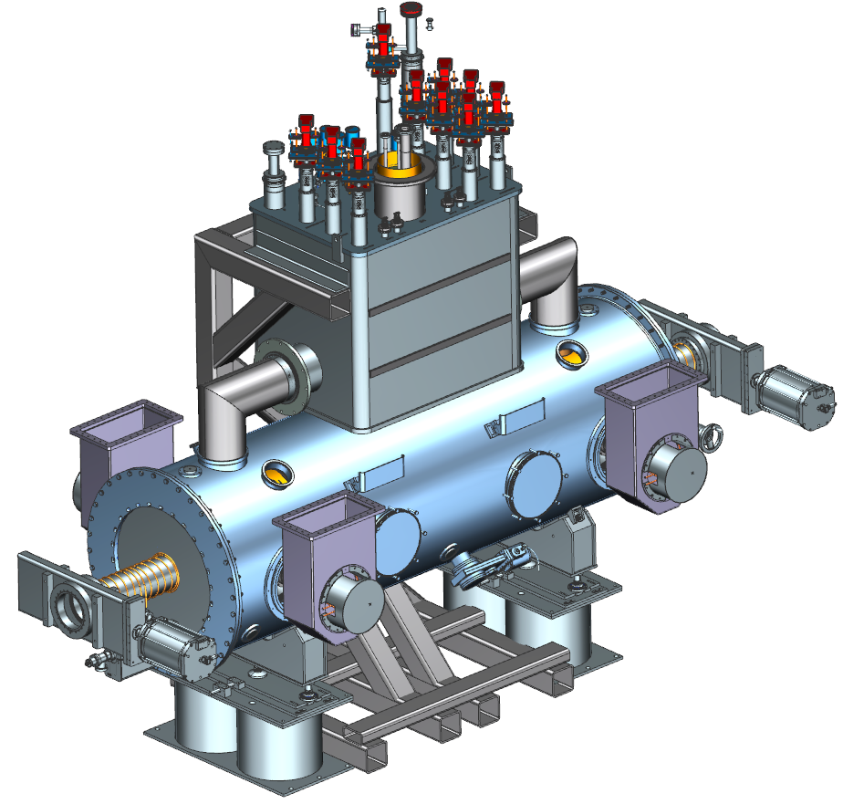
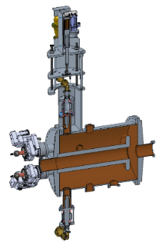
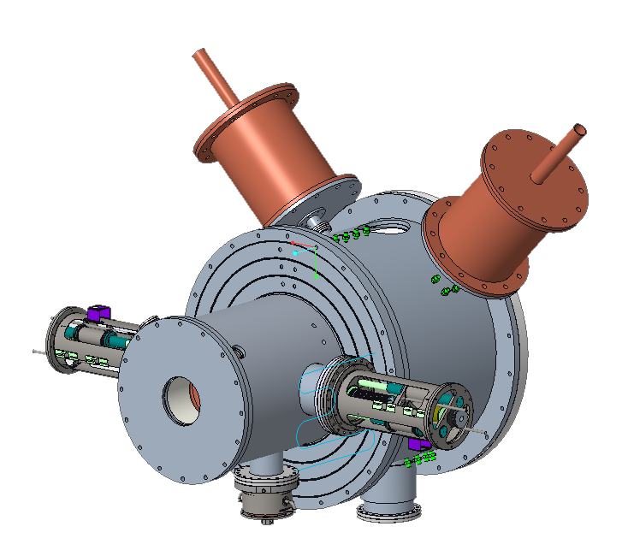
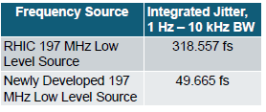
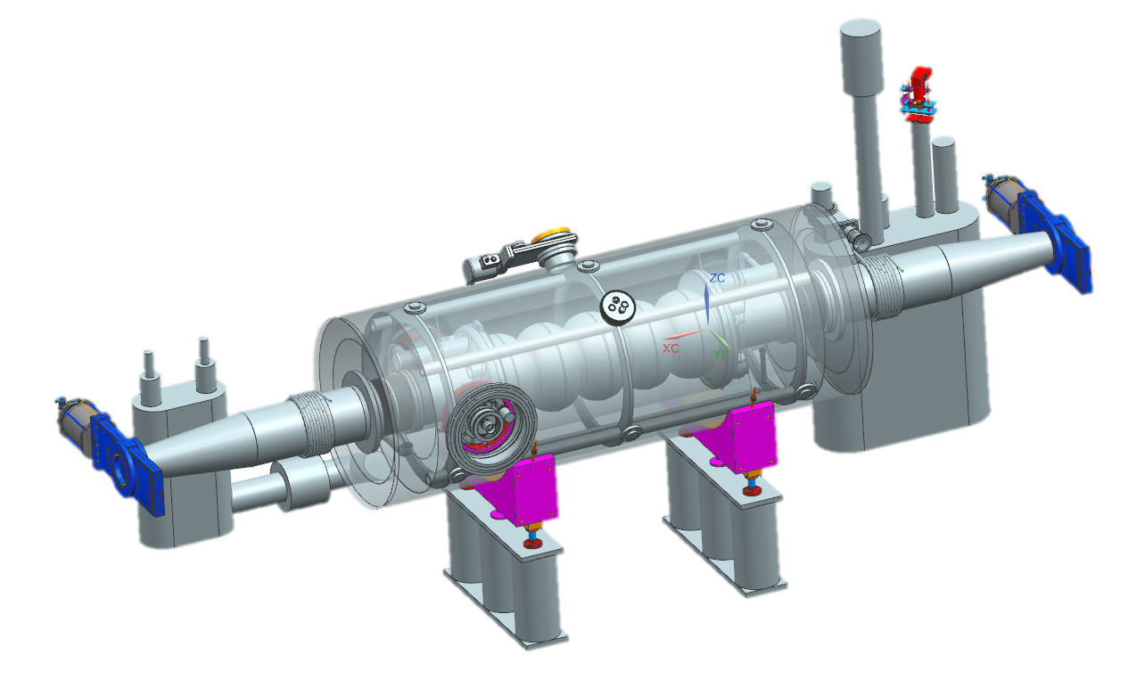
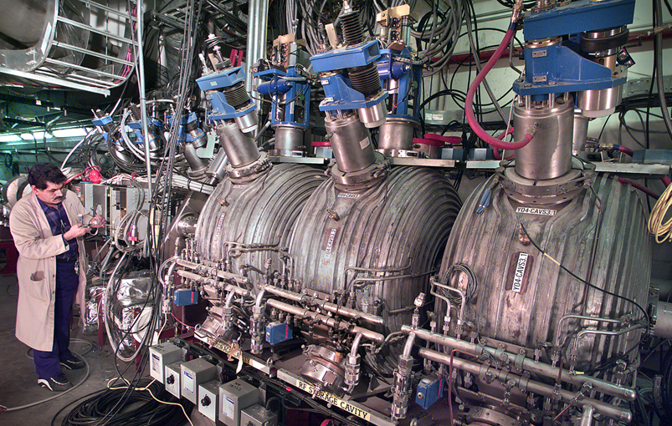
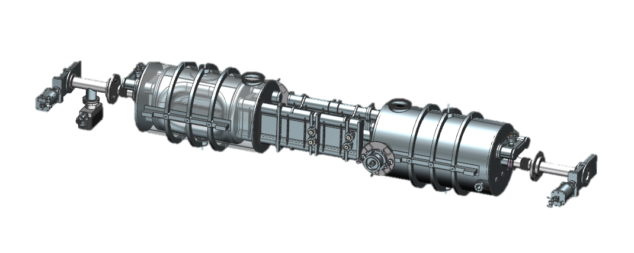
EIC RF Systems Distribution
*The Project is pre-CD2 and in the design phase.
Many systems are still developing.
Low-Energy Cooler- IR02
197 QWR NCRF,
591 NCRF,
24 MHz NCRF,
591 MHz Deflecting Cavity
400 kW Solid State Amplifier
Electron Storage Ring & Hadron Storage Ring – IR10
591 MHz 800 kW 2 K
1-Cell Cavity Cryomodules
ESR = 9 CMs, 18 Cav
HSR = 3 CMs, 6 Cav
HSR NCRF – IR04
RHIC – 28 MHz acceleration cavity (Modify and Reuse)
24.6 MHz Capture & Accel Cavity
New LLRF clocking scheme reduces phase noise for 197 MHz RF
Bunch Splitting (New)
49.2 MHz NCRF
98.5 MHz NCRF
Crab Cavities (per IR) | HSR (Cavities/CMs) | ESR (Cavities/CMs)
197 MHz | 8/4 | –
394 MHz | 4/4 | 2/2
IR06
RCS
591 MHz 5-Cell Cavity Cryomodules
RHIC – 197 MHz NCRF capture & acceleration cavity (Reuse)
c/o: Zack Conway

Slide 11
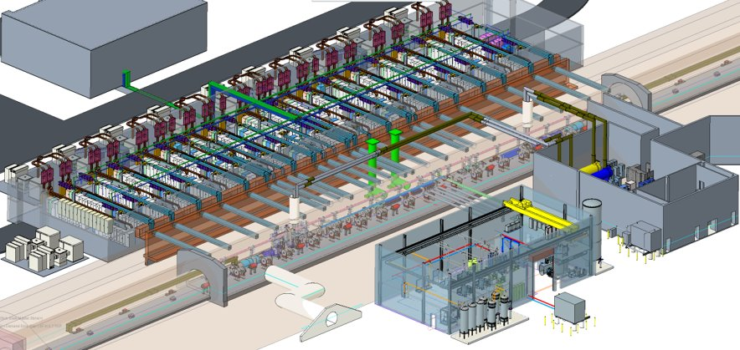
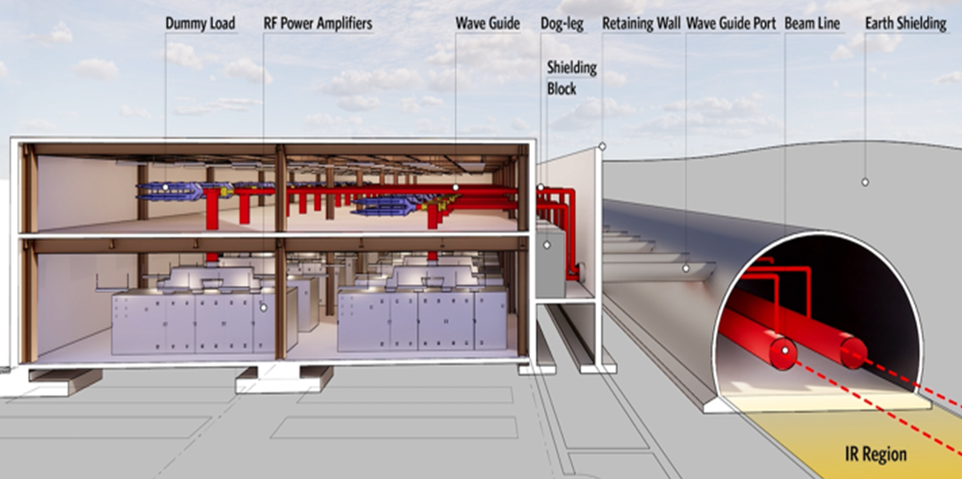
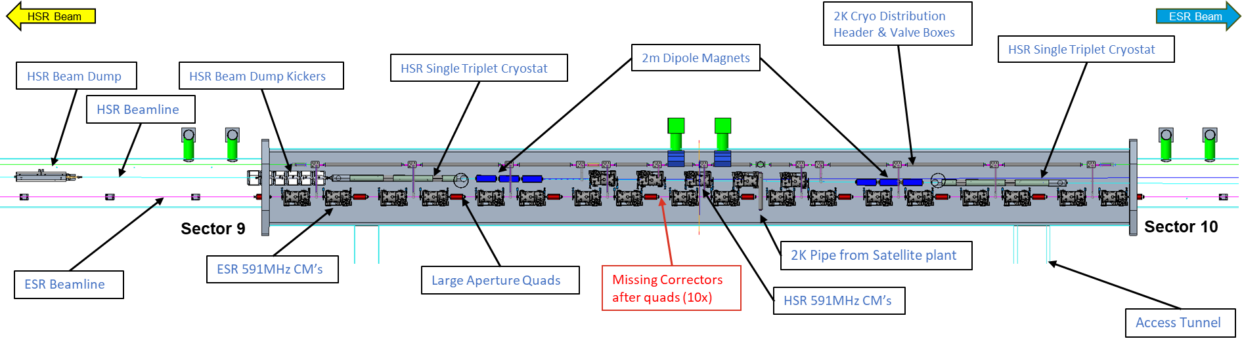
IR-10 Layout with RF Support Building
EIC Machine Center
c/o G. Dacos

Slide 12
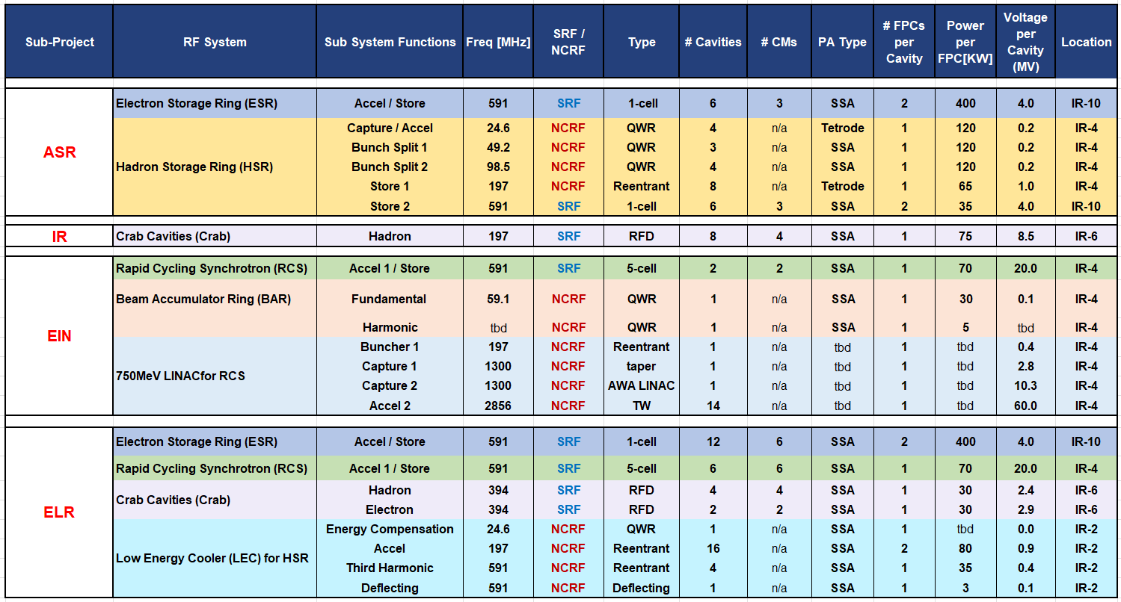
RF Systems and Quantities
Frequency range:
24.6 MHz to 2.8 GHz
Total # cavities: 106
* The Project is pre-CD2 Many systems are still developing.

Slide 13
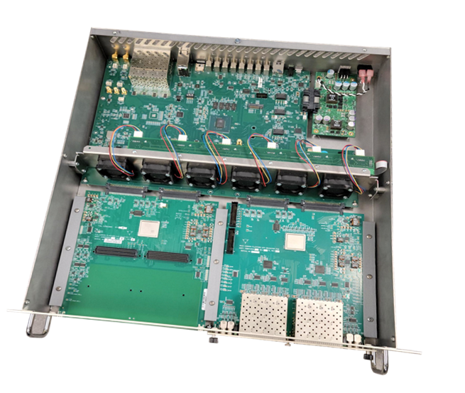
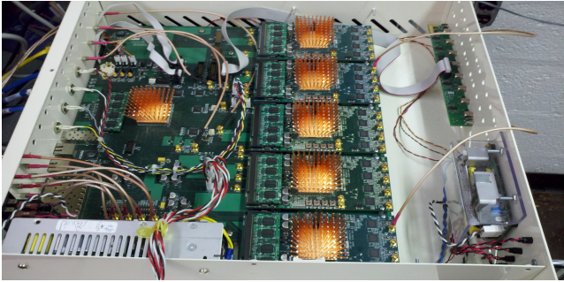

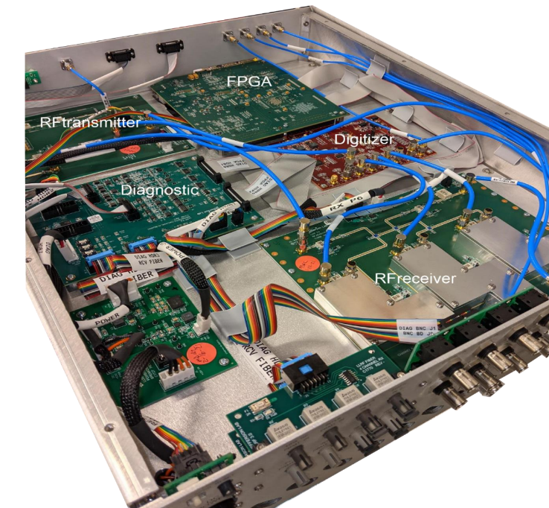
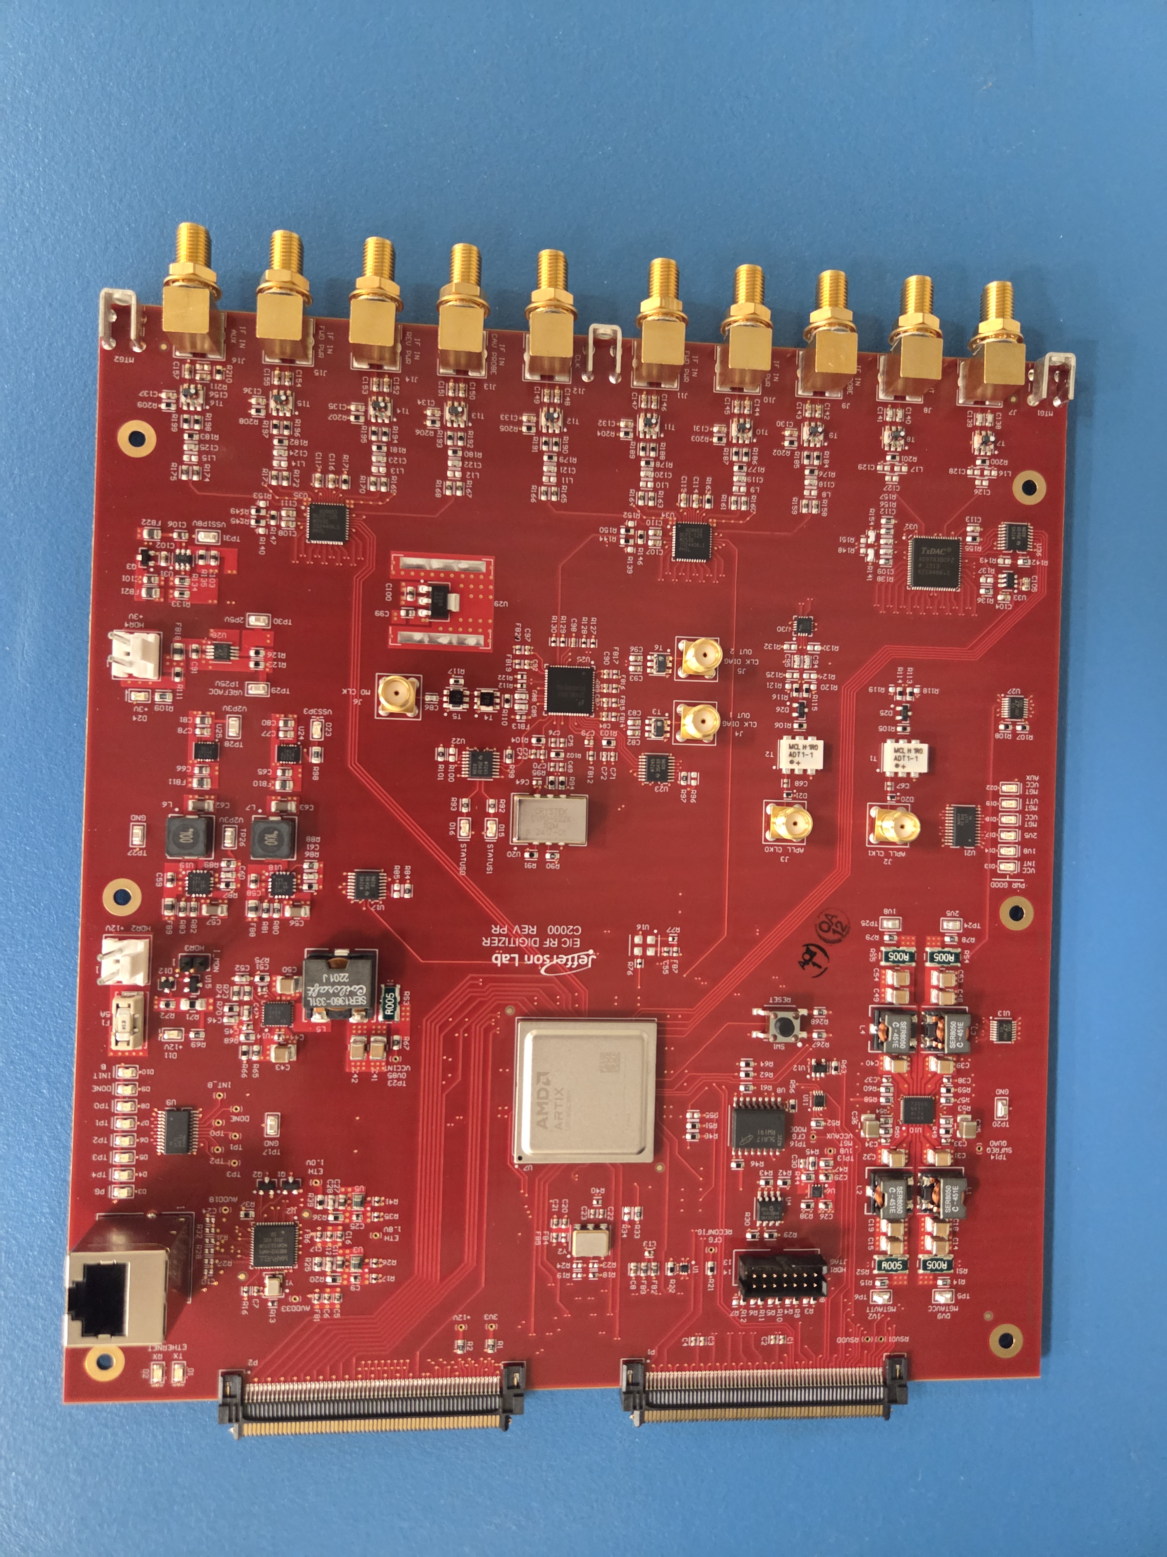
EIC RF Systems – RF Controls
EIC RF Controls development is an outgrowth of decades of RHIC LLRF and CEBAF LLRF development.
PIP-II → Linac LLRF System
LCLS-II → Linac LLRF System
SNS → Accumulator Ring RF System
RF Controls for the EIC
Synchronization of many accelerators.
LLRF, machine protection, monitoring, interfaces (cryogenics, vacuum, etc).
Leveraging both teams’ excellence for EIC
RHIC LLRF Platform
EIC Common Platform
JLAB LLRF Field Controller
EIC RF Digitizer
c/o: K. Mernick
c/o: R. Bachimanchi

Slide 14
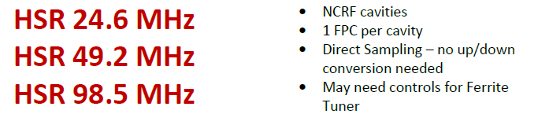
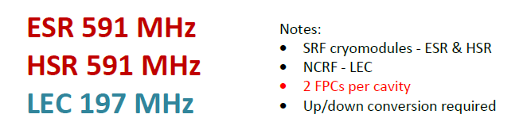
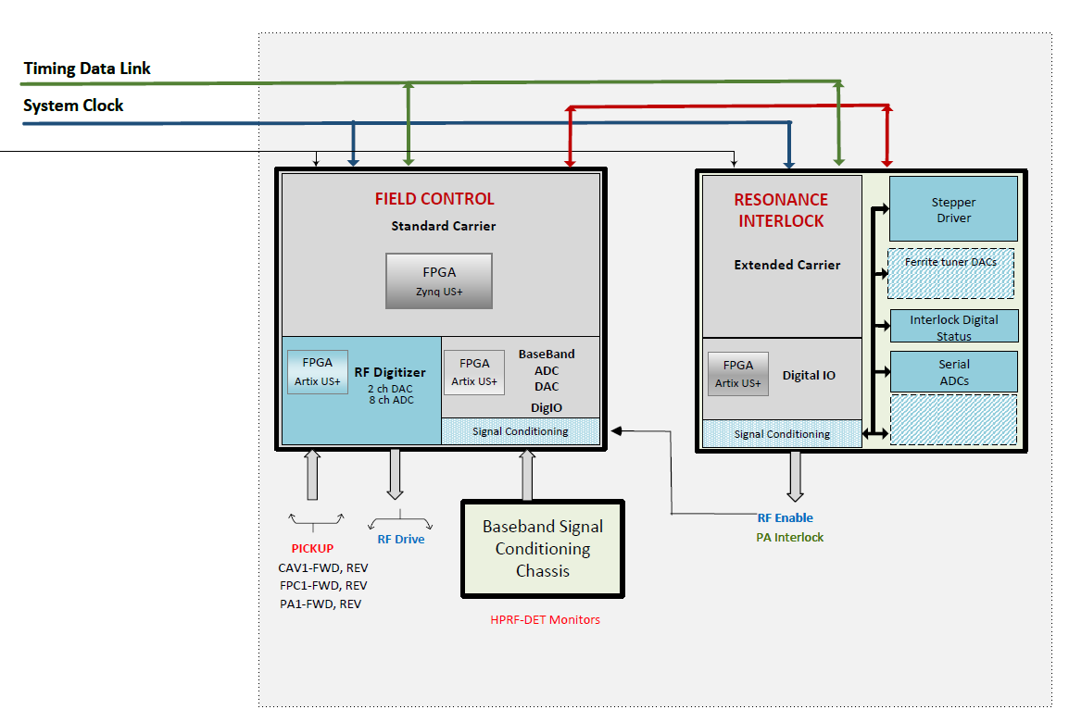
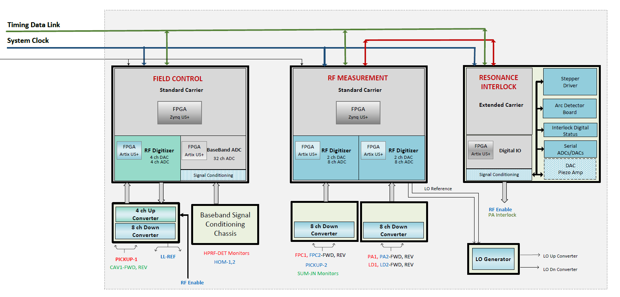
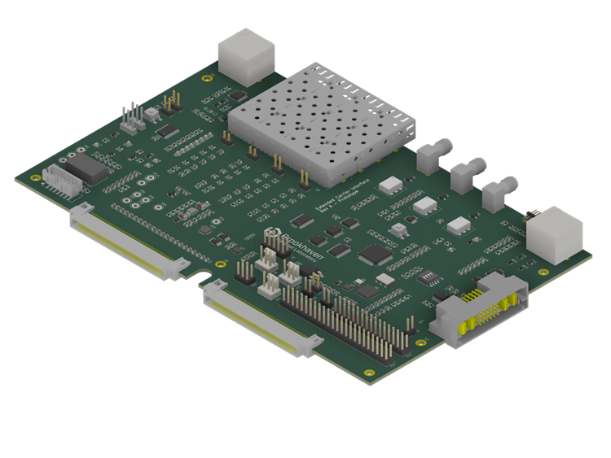
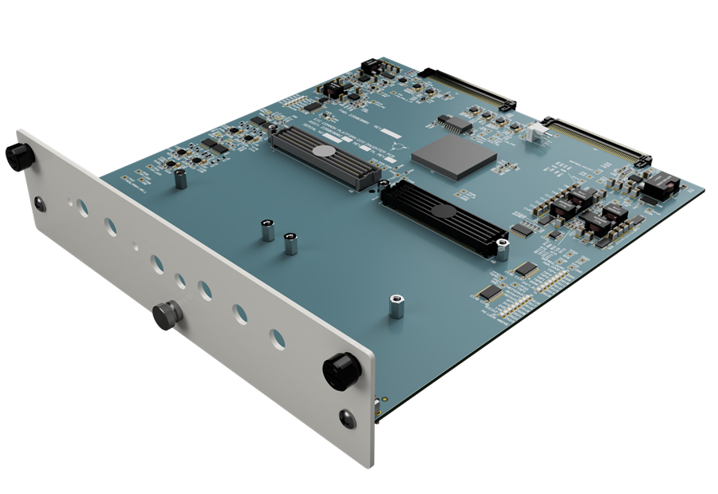
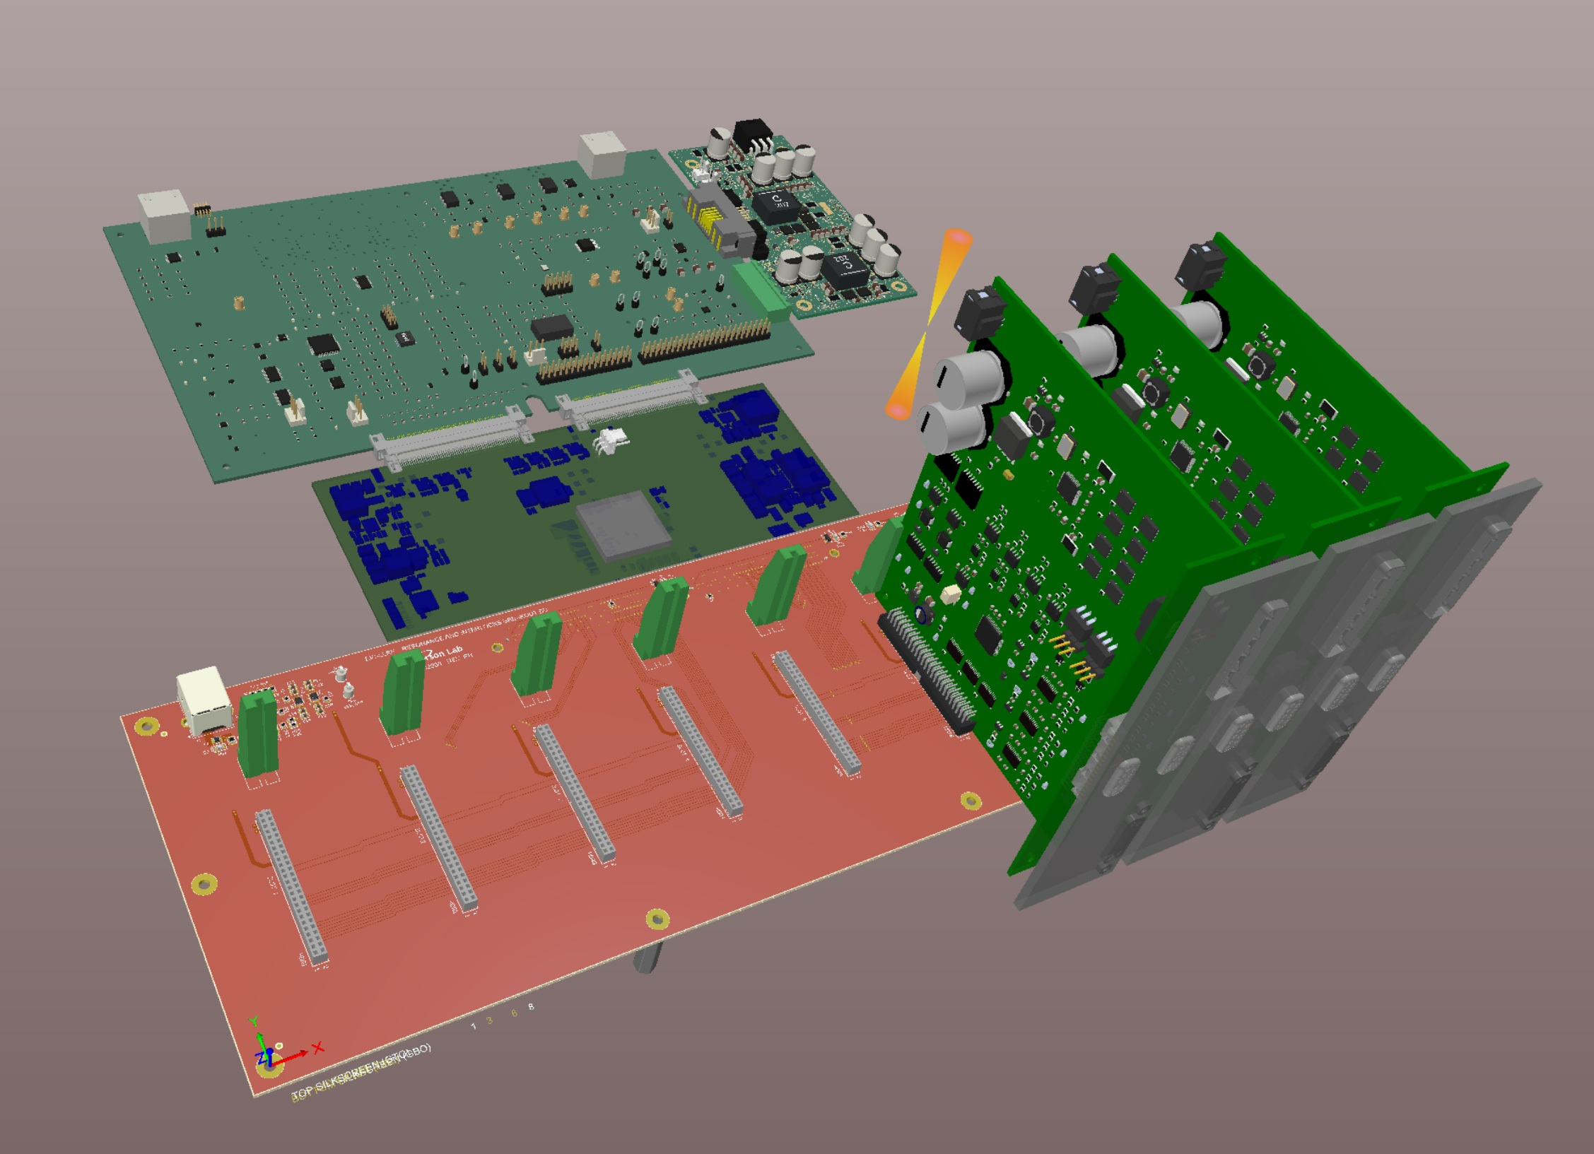
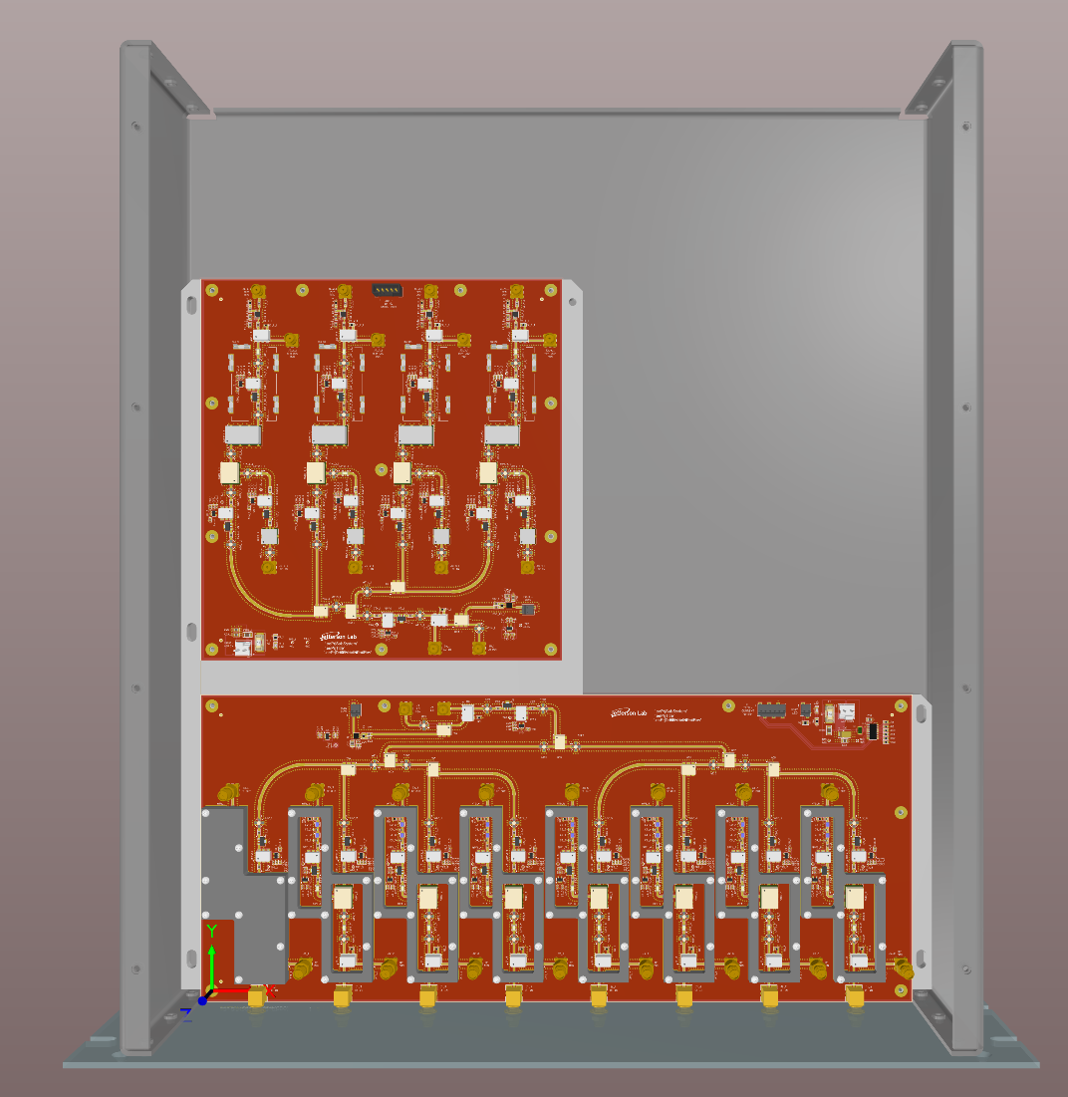
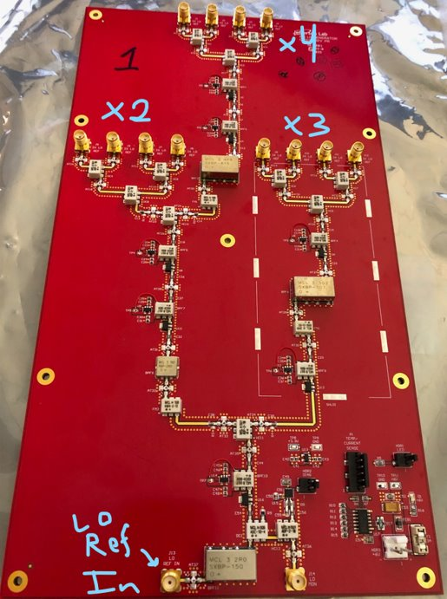
EIC LLRF – Modular and Scalable
Extended Carrier
Resonance and Interlock
4 Ch Upconverter
8 Ch Downconverter
Digital I/O
LO Generator
c/o S. Tajne
c/o K. Hernandez
c/o J. Settle
c/o J. Latshaw

Slide 15
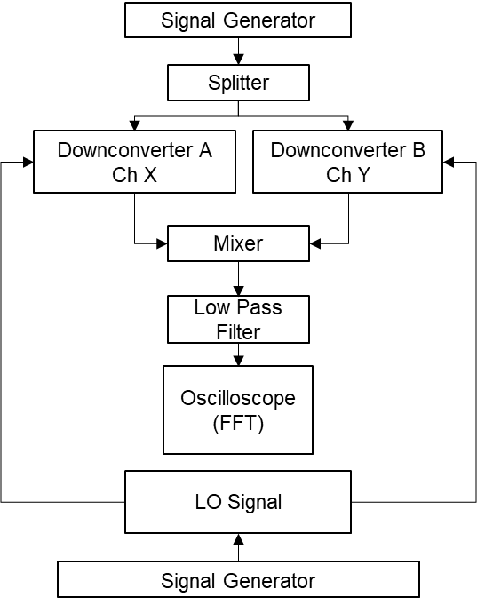
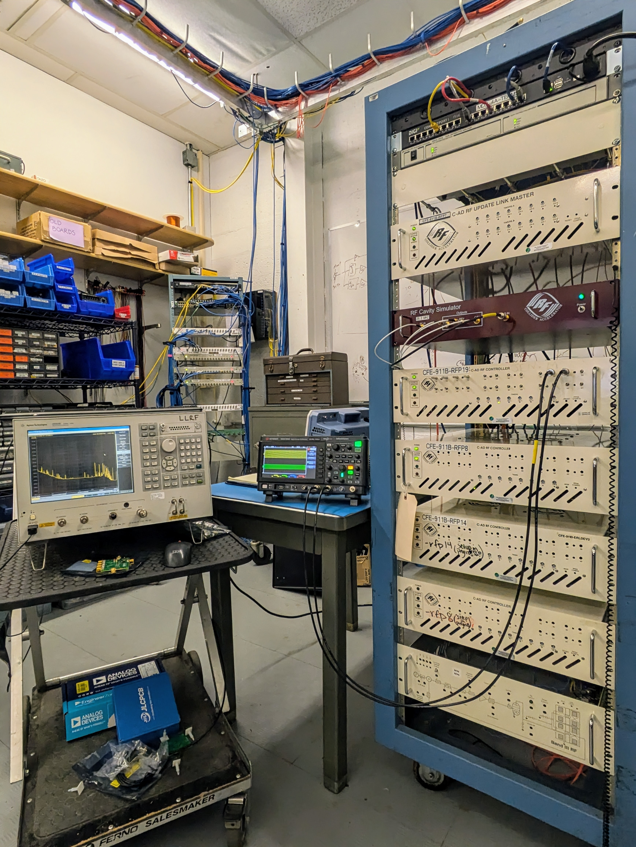
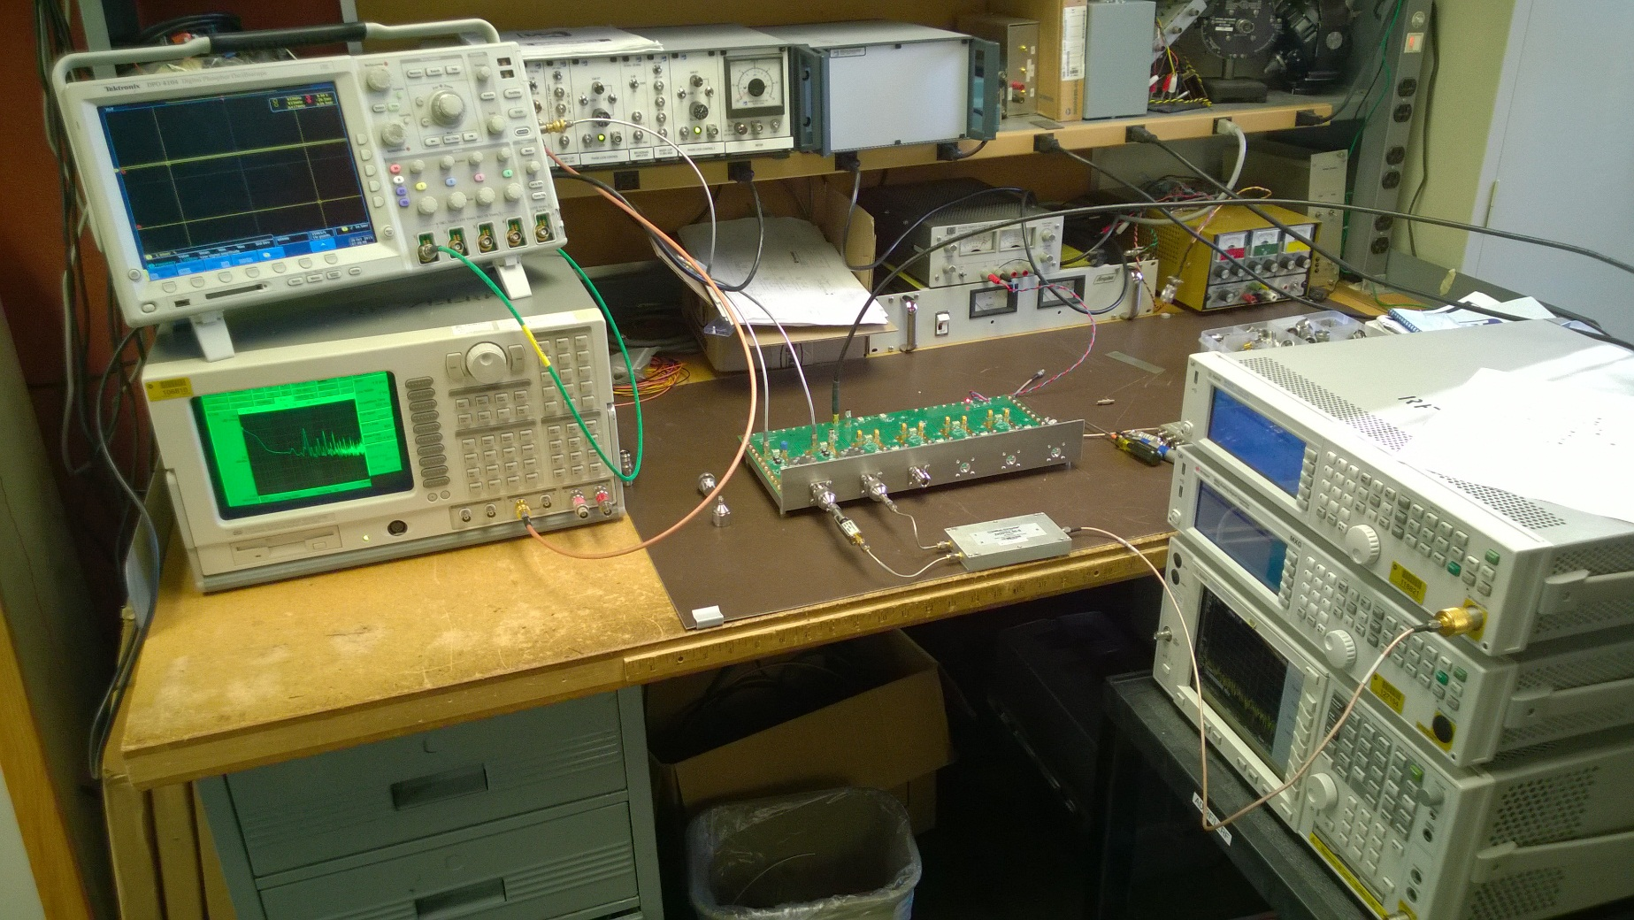
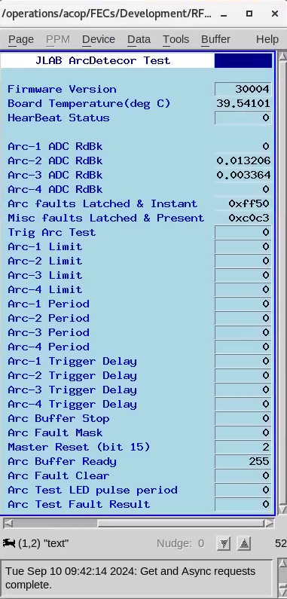
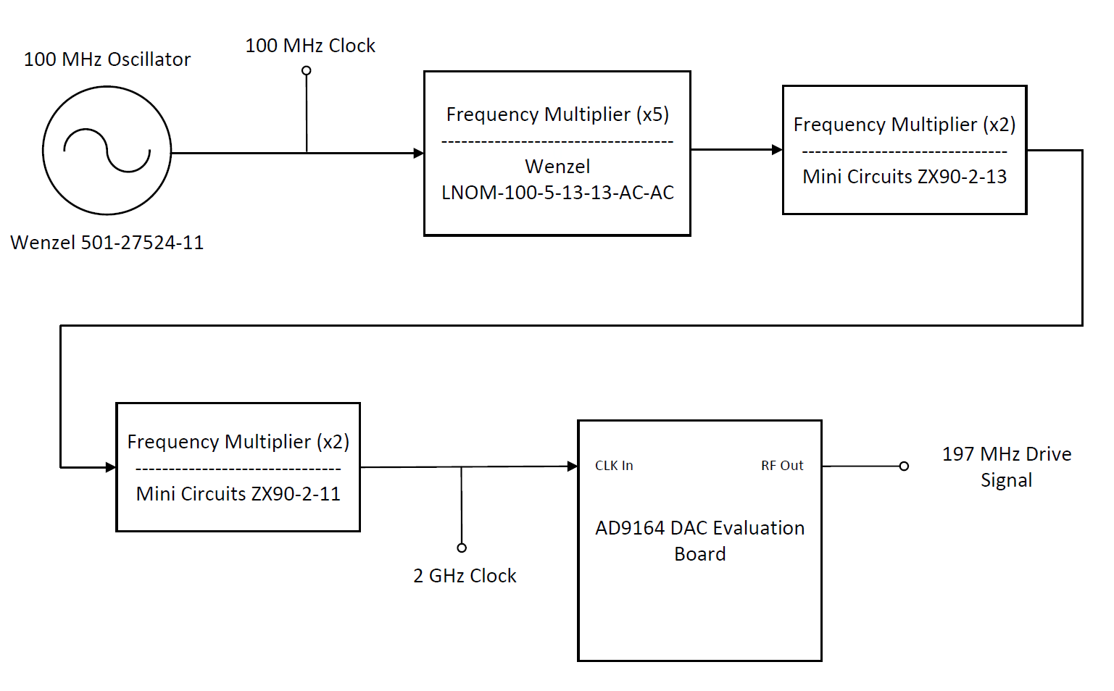
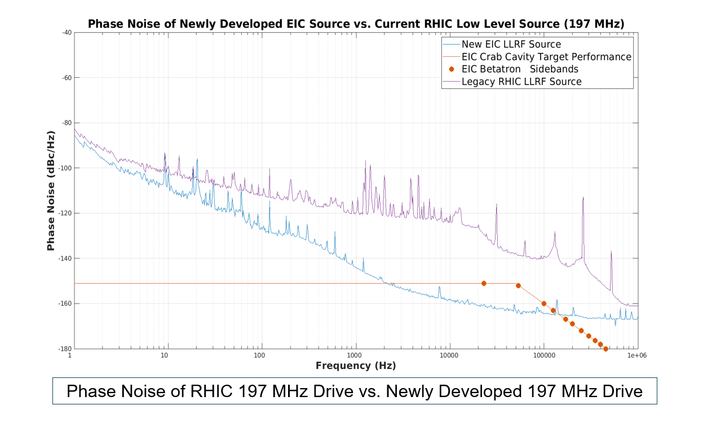
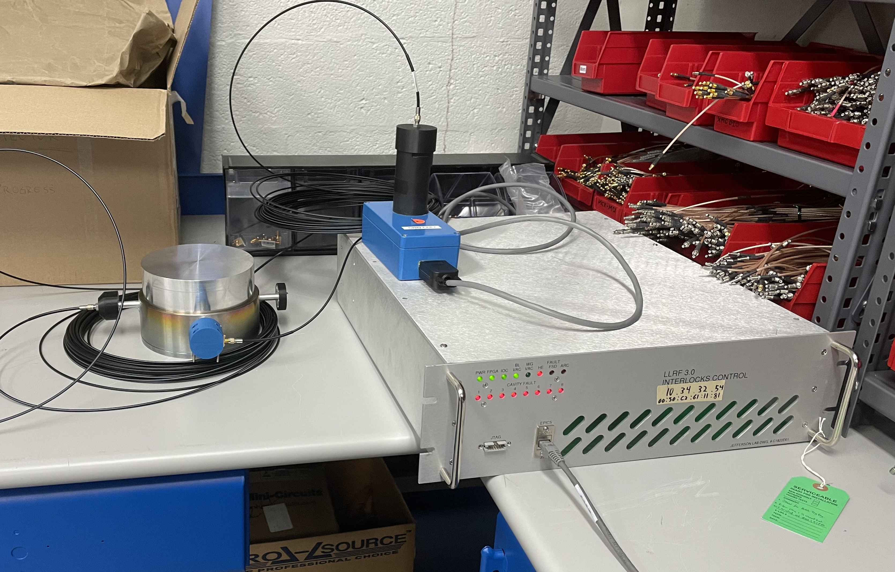
RF Controls Tests in Progress
Analog Cavity Emulator and FPGA Cavity Simulator (BNL)
– enabling early development of LLRF
Residual Noise Test on Analog Down Converters (JLAB)
c/o J. Settle
c/o A. Singh, S. Mai
Evaluating AD9164 DAC @ 197MHz for Crab Cavity (BNL) requirements with an ultra-low phase noise Wenzel source
JLAB Arc Detector – 591MHz FPC Mockup Test (BNL & JLAB)
using RHIC ADO to EPICS bridge for
data monitoring and logging
c/o F. Severino
c/o M. McCooey
c/o K. Fahey

Slide 16
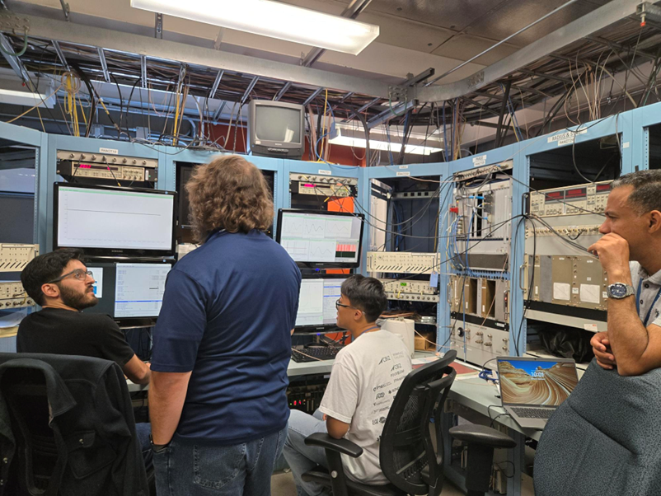
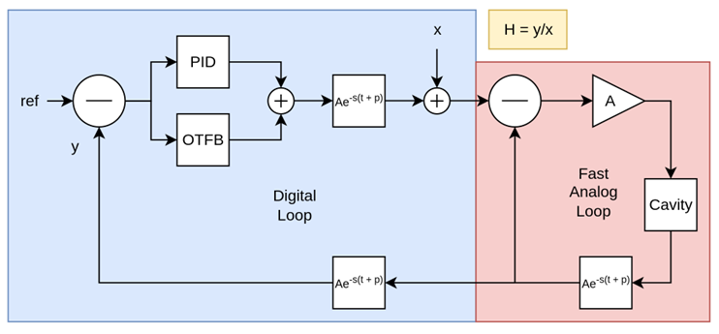
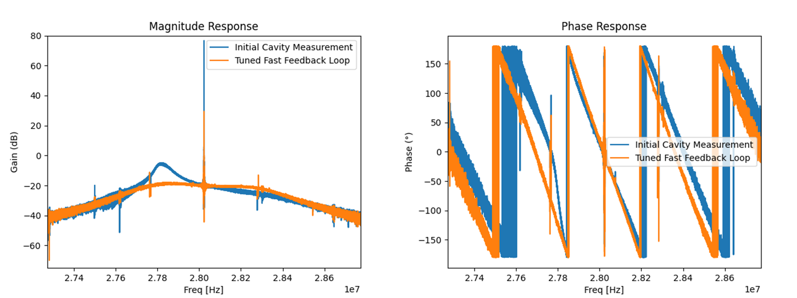
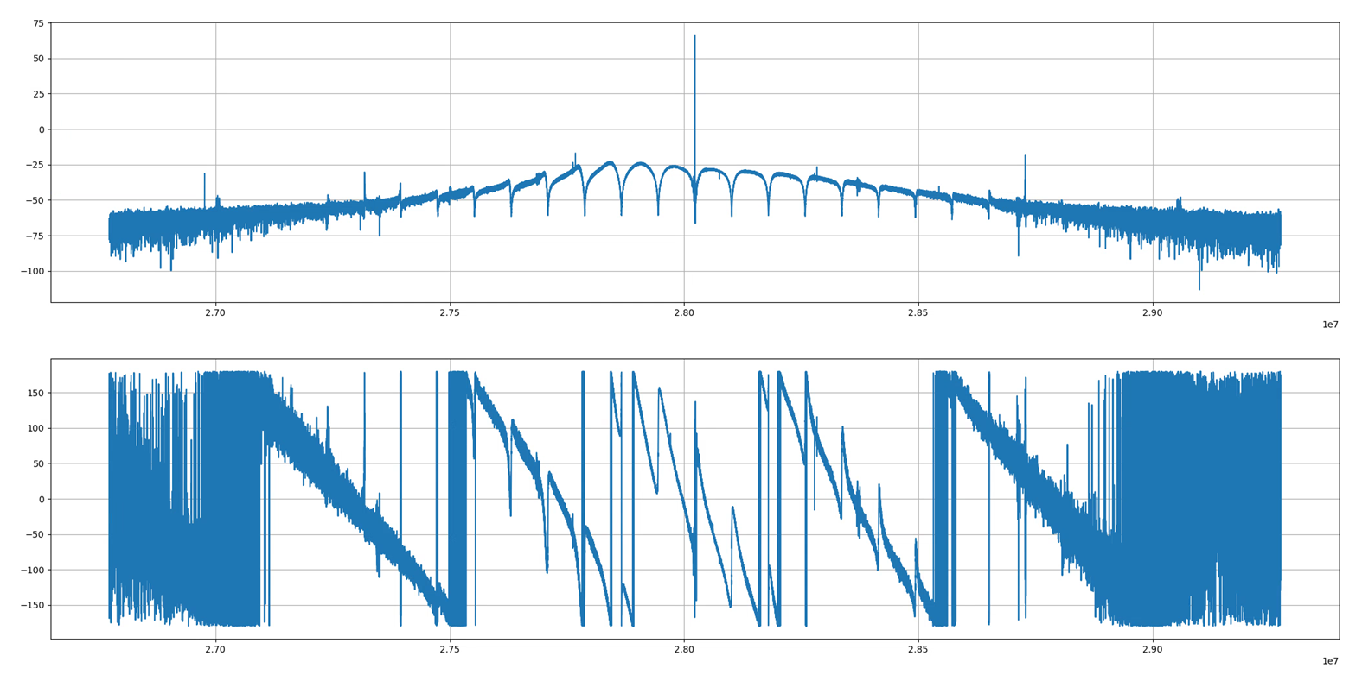
A view from RHIC APEX Studies
Goal:
Measure and compensate for transient beam loading in RHIC yellow 28MHz accelerating cavity
Designs under Test:
One-Turn Delay Feedback
Feed Forward compensation
Digital Network Analyzer (DNA)
Bunch-by-bunch ADC
(amplitude and phase measurement)
Date: 9/17/2025
To tune the loop, DNA is used in an iterative process, to take measurements
Model parameters are tweaked until response fits the measurement.
Digital Network Analyzer used to measure the System Response
Blue -> error in analog loop
Orange -> correction after 2.5 ns cable addition
Closed-loop system response of the 28 MHz cavity
PID, OTFB, and analog fast-feedback enabled
Up to 30 dB of gain

Slide 17
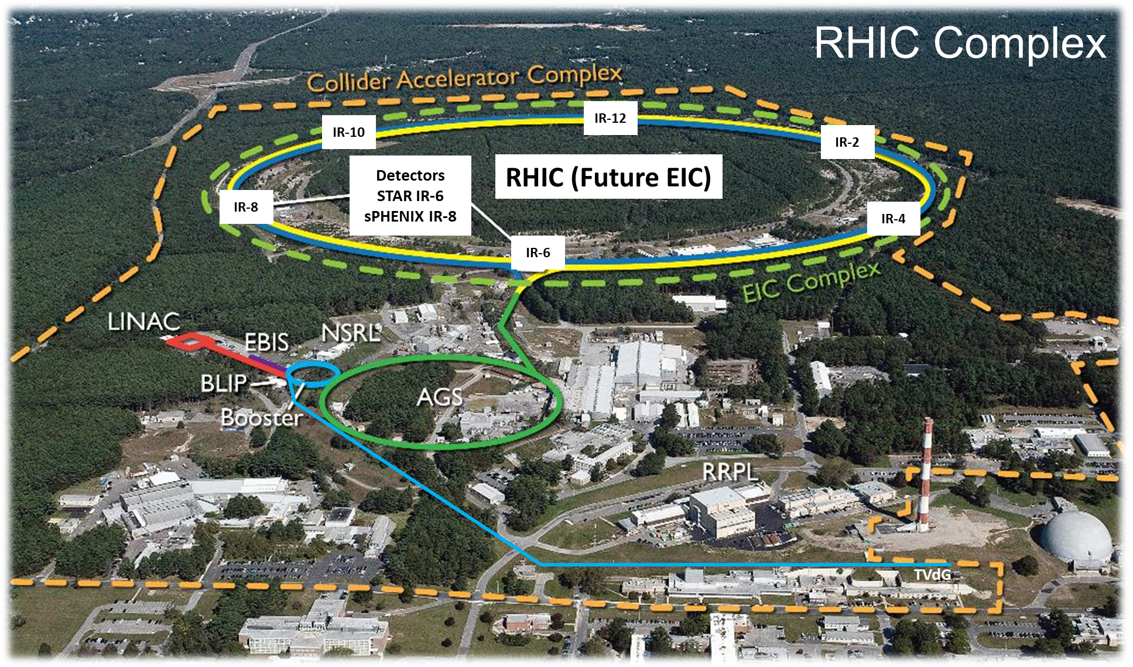

Celebrating 25 years of RHIC and Commencement of EIC
C-AD and EIC Management
Zack and Silvia (EIC RF Systems)
C-AD and EIC LLRF Team at BNL
JLAB LLRF Team
Advisers and well wishers
Curt, Tomasz, Alex Z, KSS
And many others, whose collective efforts are turning the EIC’s goal into a reality.

